Slide 1
Applied AI Mini Project
Group BJL
Boying Li
Jie Zhong
Lianhe Chu 2024-12-23

Slide 2
Agenda
Introduction
Datasets
K-fold
Preprocess
Models
Supervised
Unsupervised
Results
Summary

Slide 3
Introduction
Aiming for Grade 5
Performed an extensive set of experiments and evaluate the performance of 21 datasets from 121 UCI datasets.
Developed and evaluated 3 unsupervised and 3 supervised classification models compare to baseline performance reported in the paper.
Notes:
You have to demonstrate the usage of appropriate pre-processing techniques, systematic way of performing experiments (i.e. correct transfer of parameters between train, validation and test sets).

Slide 4
Binary Class Datasets
Data set | nr of pat. | Features | Classes | %Maj
congress-voting | 435 | 16 | 2 | 61.4
conn-bench-sonar | 208 | 60 | 2 | 53.4
magic | 19020 | 10 | 2 | 64.8
mammographic | 961 | 5 | 2 | 53.7
ozone | 2536 | 72 | 2 | 97.1
blood | 748 | 4 | 2 | 76.2
ac-inflam | 120 | 6 | 2 | 50.8
acute-nephritis | 120 | 6 | 2 | 58.3
fertility | 100 | 9 | 2 | 88.0
ilpd-indian-liver | 583 | 9 | 2 | 71.4
Data set | nr of pat. | Features | Classes | %Maj
breast cancer | 286 | 9 | 2 | 70.3
balloons | 16 | 4 | 2 | 56.2
bc-wisc | 699 | 9 | 2 | 65.5
bc-wisc-prog | 198 | 33 | 2 | 76.3
bc-wisc-diag | 569 | 30 | 2 | 62.7
credit-approval | 690 | 15 | 2 | 55.5
horse-colic | 300 | 25 | 2 | 63.7
ionosphere | 351 | 33 | 2 | 64.1
mushroom | 8124 | 21 | 2 | 51.8
spambase | 4601 | 57 | 2 | 60.6
tic-tac-toe | 958 | 9 | 2 | 65.3
Notes:
Due to time limitation, we did not test and evaluate all 121 dataset, so instead of randomly choosing 20+ dataset, we decide to focus on binary class datasets and investigate the classifiers performance of the binary class datasets.

Slide 5
Inspect dataset
Number of data instance
Dataset balanced or not
Number of feature
Feature type (Categorical or numerical)
Any missing values?
Notes:
Before doing any preprocess, the first thing we did is to load the datasets to inspect and understand the datasets.

Slide 6
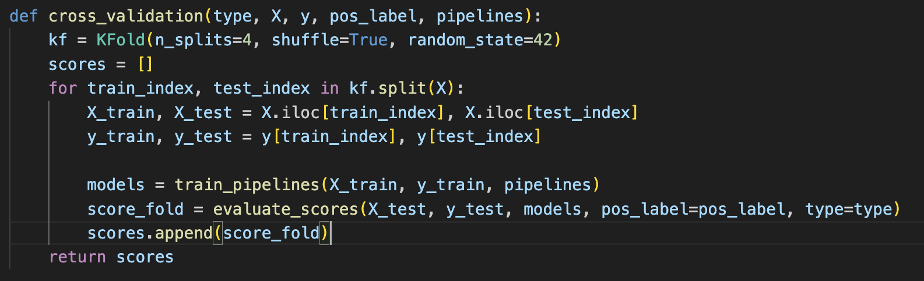
4-fold cross validation
Instead of splitting the datasets into train/test sets, we use the average of 4-fold cross validation as the test result.
Notes:
More Reliable Performance Estimates: K-fold cross-validation splits the data into K subsets (folds) and uses each subset as a test set while training on the remaining K-1 folds. This process is repeated K times, and the performance metrics are averaged. This leads to a more reliable estimate of the model's performance since it considers multiple train-test splits.
Better Use of Data: With a single train-test split, some data might not be used in either the training or testing phase. K-fold cross-validation ensures that every data point is used for both training and testing, maximizing the use of the available data.

Slide 7
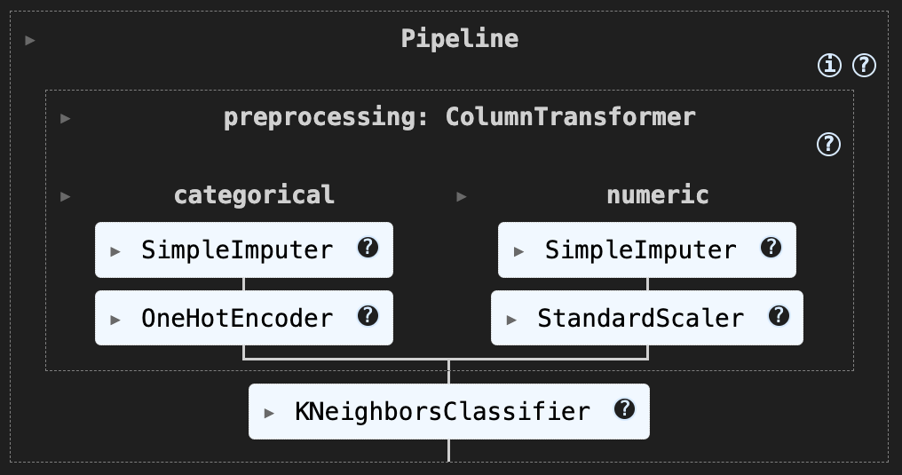
Preprocess Pipeline Diagram
Notes:
we created a pipeline to sequentially apply a list of transformers to preprocess the data. To deal with missing values, for categorical feature we use ‘most frequent’ to impute the value, and for numerical feature we use ‘mean’ to impute the value. Then onhotencoder is applied to the categorical features. And numerical features are Z-normalized, here we have to note that the statistics (which is mean and std) are from the train fold, and the test fold use train fold statistics to do the z-normalization to avoid data leakage.

Slide 8
Models
Supervised learning
KNN
SVM
Random Forest
Unsupervised learning
KMeans
Birch
MeanShift

Slide 9
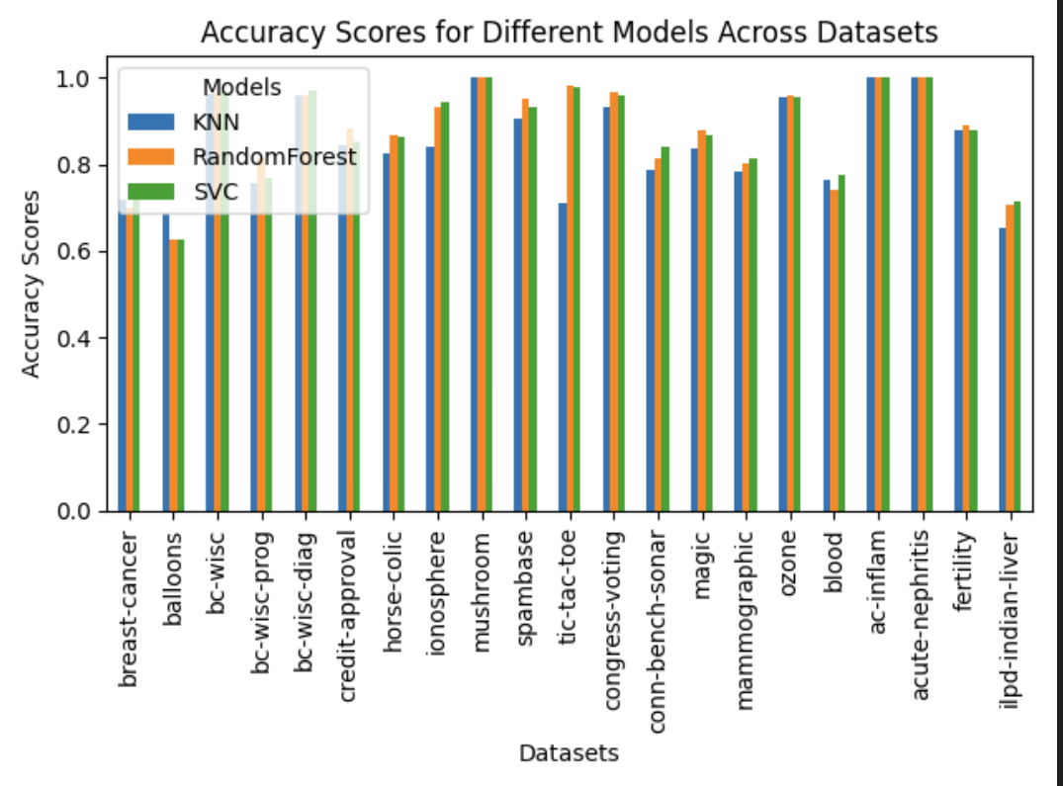
Supervised learning - Accuracy

Slide 10
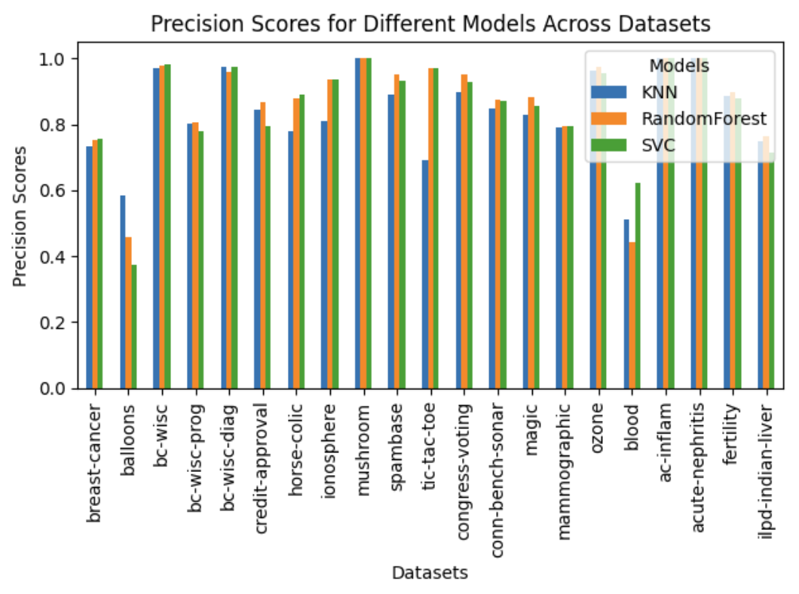
Supervised learning - Precision

Slide 11
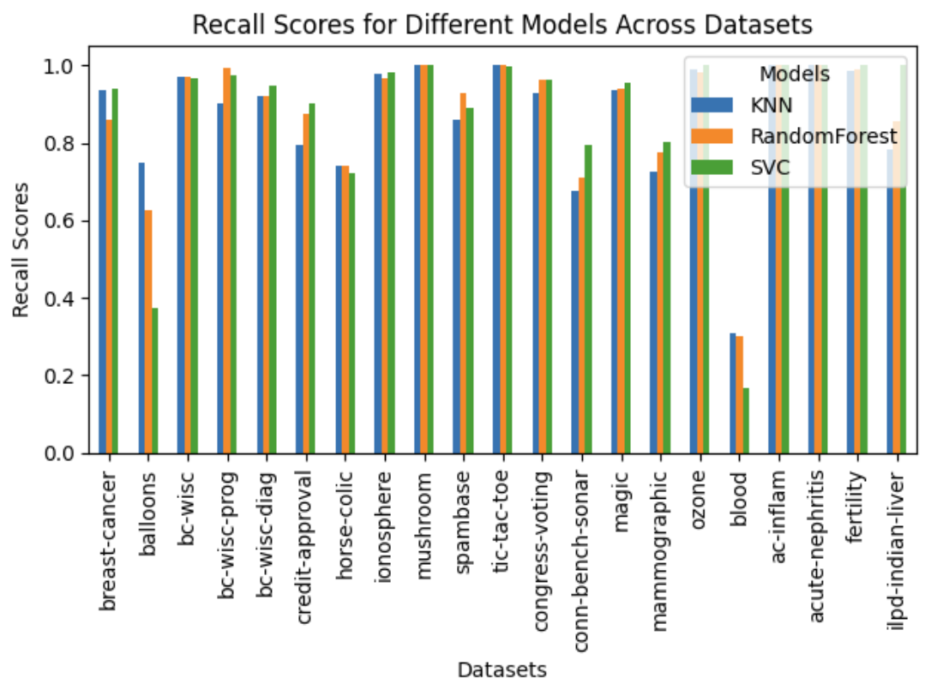
Supervised learning - Recall

Slide 12
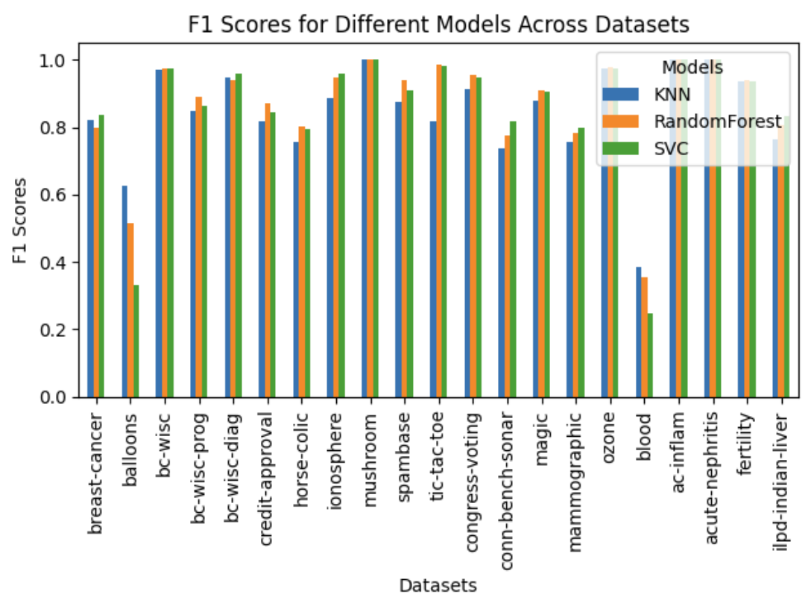
Supervised learning - F1_score

Slide 13

Supervised learning - average
 | KNN | Random Forest | SVC
Accuracy | 0.8477 | 0.8783 | 0.8784
Precision | 0.8365 | 0.8640 | 0.8576
Recall | 0.8665 | 0.8762 | 0.8754
F1 | 0.8438 | 0.8656 | 0.8533

Slide 14
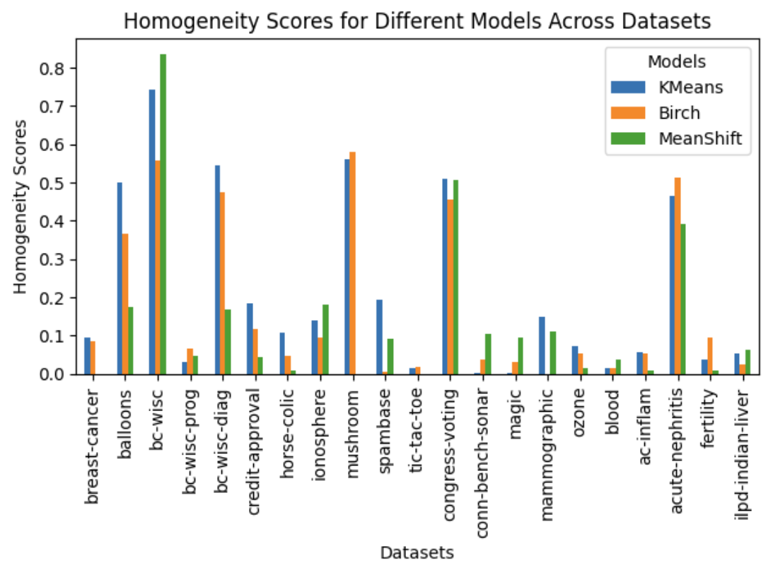
Unsupervised learning - Homogeneity

Slide 15
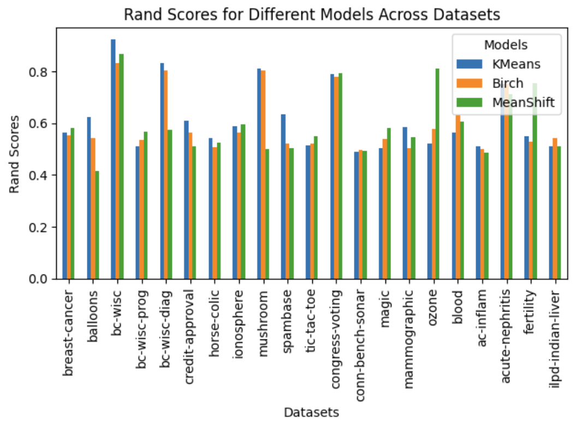
Unsupervised learning - Rand index

Slide 16
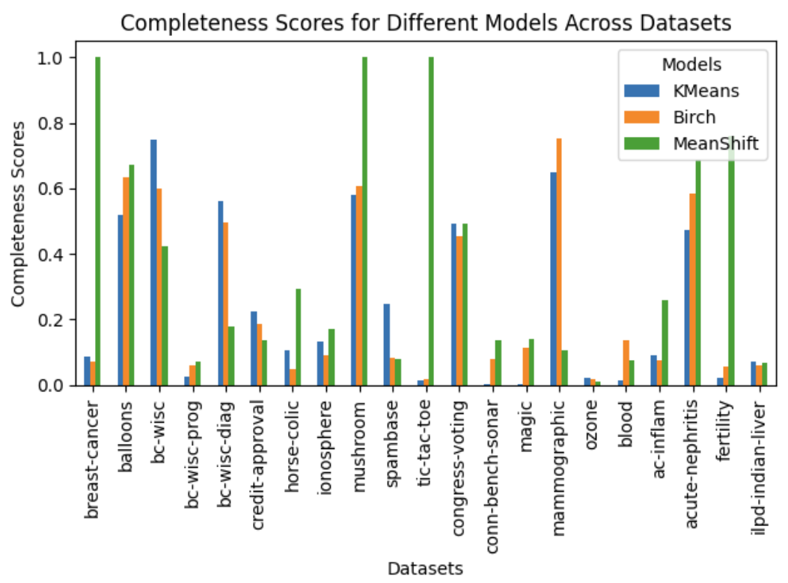
Unsupervised learning - Completeness

Slide 17
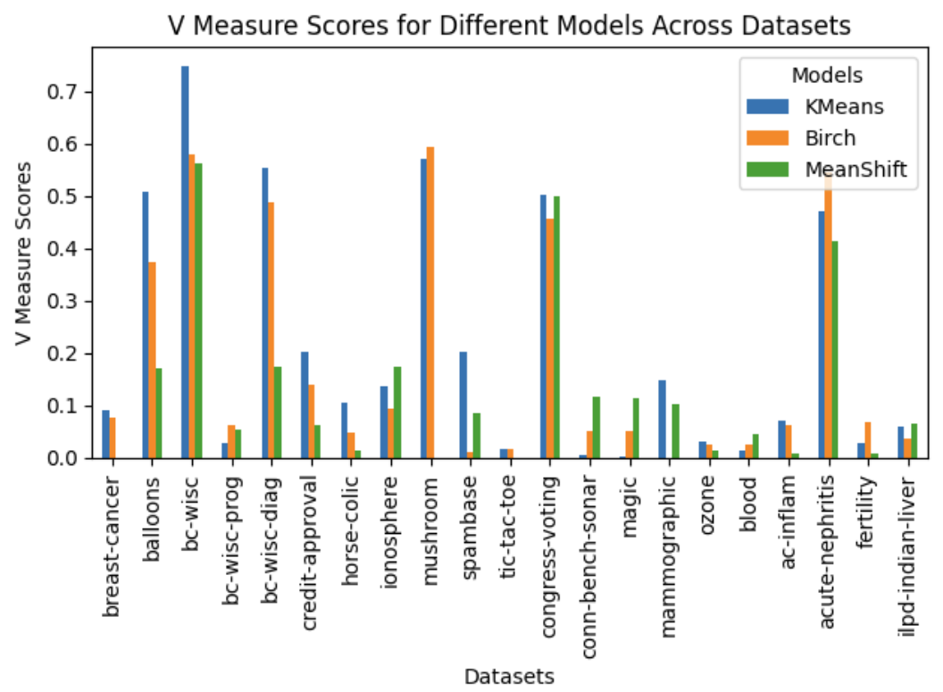
Unsupervised learning - V_measure

Slide 18
Unsupervised learning - average
 | KMeans | Birch | MeanShift
Homogeneity | 0.2133 | 0.1758 | 0.1374
Rand index | 0.6158 | 0.5999 | 0.5943
Completeness | 0.2423 | 0.2490 | 0.3699
V-measure | 0.2136 | 0.1807 | 0.1275
Notes:
1. Homogeneity
Definition: Measures whether all the clusters contain only data points that are members of a single class.
Interpretation: A homogeneity score of 1 means that each cluster contains only one class, while 0 indicates no homogeneity.
2. Rand Index
Definition: Evaluates the similarity between two data clusterings by considering all pairs of samples and counting pairs that are either correctly clustered together or correctly not clustered together.
Formula:
RI=TP+TNTP+FP+FN+TNRI = \frac{TP + TN}{TP + FP + FN + TN}
3. Completeness
Definition: Measures whether all the data points that are members of a given class are assigned to the same cluster.
Interpretation: A completeness score of 1 means that all the data points of a class are in the same cluster, while 0 indicates no completeness.
4. V-Measure
Definition: The harmonic mean of homogeneity and completeness.
Formula:
V=2×homogeneity×completenesshomogeneity+completenessV = 2 \times \frac{\text{homogeneity} \times \text{completeness}}{\text{homogeneity} + \text{completeness}}
Advantages: It balances both homogeneity and completeness, ensuring a more robust evaluation.

Slide 19
Compare with the paper’s result
Data set | KNN | KNN_caret | RF | parallel RF* | SVC | SVM_C
congress-voting | 0.9310 | 0.6230 | 0.9678 | 0.6250 | 0.9586 | 0.608
conn-bench-sonar | 0.7884 | 0.8170 | 0.8125 | 0.8270 | 0.8413 | 0.856
magic | 0.8354 | 0.8390 | 0.8797 | 0.88 | 0.8687 | 0.877
mammographic | 0.7835 | 0.81 | 0.8043 | 0.8090 | 0.8126 | 0.825
ozone | 0.9540 | 0.9720 | 0.9595 | 0.9710 | 0.9542 | 0.972
blood | 0.7660 | 0.79 | 0.7419 | 0.7490 | 0.7740 | 0.773
ac-inflam | 1.0 | 1.0 | 1.0 | 1.0 | 1.0 | 1.0
acute-nephritis | 1.0 | 1.0 | 1.0 | 1.0 | 1,0 | 1.0
fertility | 0.88 | 0.88 | 0.89 | 0.88 | 0.88 | 0.88
ilpd-indian-liver | 0.6535 | 0.71 | 0.7066 | 0.6840 | 0.7135 | 0.711
*parallel rf implemented in R with caret achieved the best result in the paper

Slide 20
Compare with the paper’s result - continued table
Data set | KNN | KNN_caret | RF | parallel RF* | SVC | SVC
breast cancer | 0.7169 | 0.7480 | 0.6992 | 0.7310 | 0.7448 | 0.75
balloons | 0.6875 | 0.5670 | 0.625 | 0.6670 | 0.625 | 0.8120
bc-wisc | 0.9614 | 0.9690 | 0.9670 | 0.9660 | 0.9670 | 0.9610
bc-wisc-prog | 0.7570 | 0.7780 | 0.8127 | 0.8090 | 0.7674 | 0.811
bc-wisc-diag | 0.9613 | 0.9670 | 0.9577 | 0.9680 | 0.9701 | 0.97
credit-approval | 0.8435 | 0.8520 | 0.8840 | 0.8750 | 0.8507 | 0.862
horse-colic | 0.8261 | 0.8380 | 0.8668 | 0.8820 | 0.8641 | 0.868
ionosphere | 0.8405 | 0.8460 | 0.9344 | 0.9320 | 0.9458 | 0.949
mushroom | 1.0 | 1.0 | 1.0 | 1.0 | 1.0 | 1.0
spambase | 0.9043 | 0.9050 | 0.9528 | 0.9510 | 0.9308 | 0.938
tic-tac-toe | 0.7107 | 0.9950 | 0.9811 | 0.9910 | 0.9780 | 1.0
Paper result
*parallel rf implemented in R with caret achieved the best result in the paper

Slide 21
Summary
Supervised models and unsupervised models are evaluated separately, for sure we can manually assign labels to clusters by examining the majority class of the data points within each cluster, then calculate the accuracy for the unsupervised models’ output. But we think it makes more sense to evaluate them separately with different metrics.
Our results are comparable with the benchmark results from the paper
In our experiments, Random Forest performs generally better than SVM and KNN
In our experiments, Kmeans performs generally better than Birch and MeanShift

Slide 22
Doubts about the paper...
Section 3 ‘Results and Discussion’ the validation methodology: dataset is split into 50% as train and 50% as test for parameter tuning, then use the whole dataset and the tuned hyperparameters to do the 4-fold cross validation as the test result, doesn’t it lead to data leakage??
Wrong metadata for ‘chess dataset’: it should be 36 features + 1 label, but in metadata the 36th feature is processed as label.
One minor suggestion for the paper: the naming of the datasets presented in the paper is not perfectly aligned with the benchmark result file :-(

Slide 23
References
https://jmlr.org/papers/volume15/delgado14a/delgado14a.pdf

